Slide 1
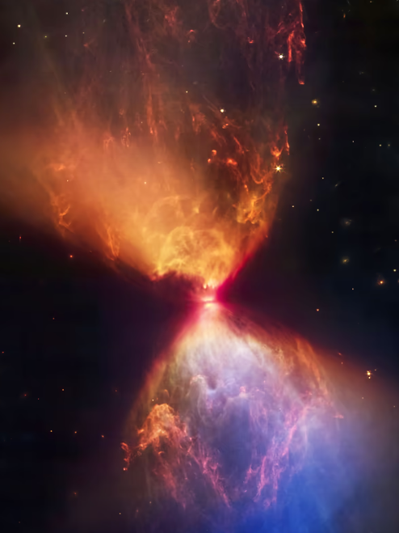

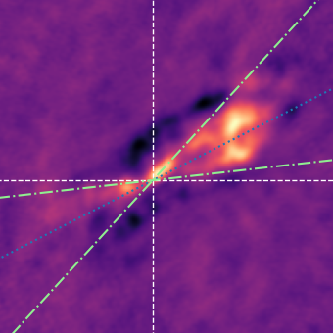
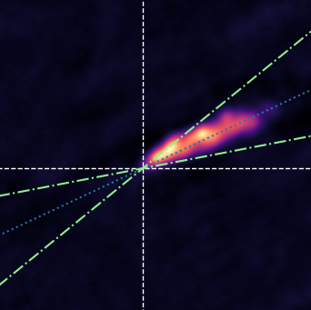
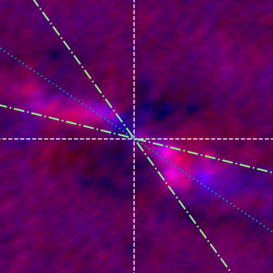
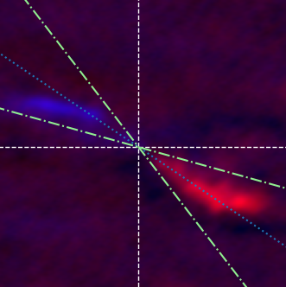
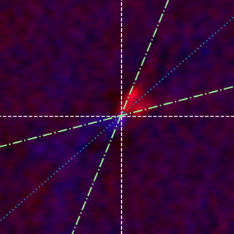
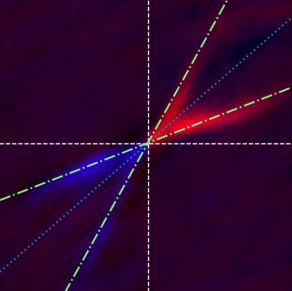
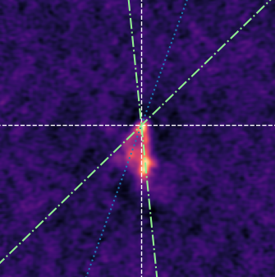
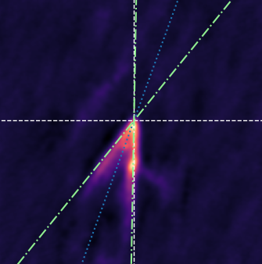
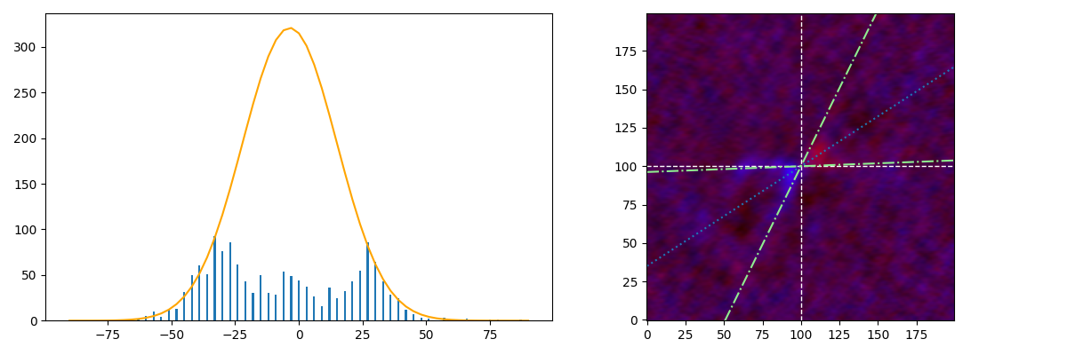
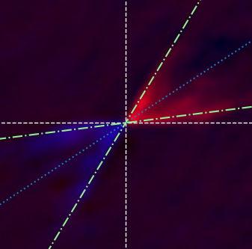
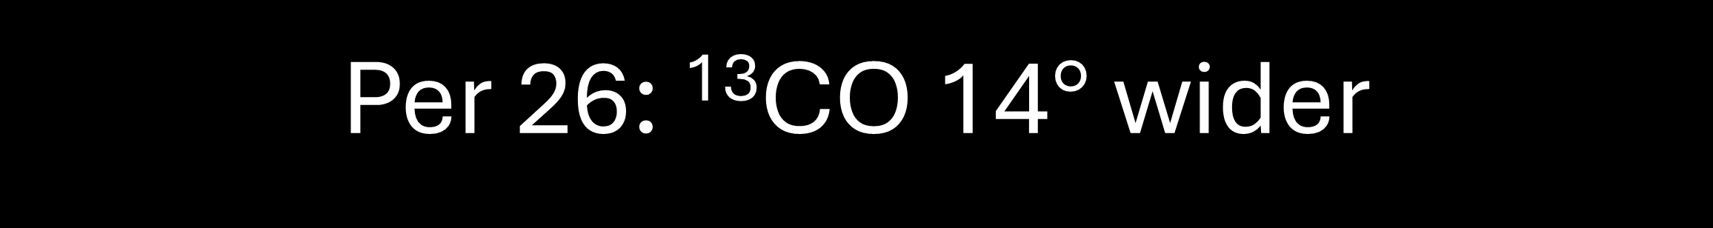
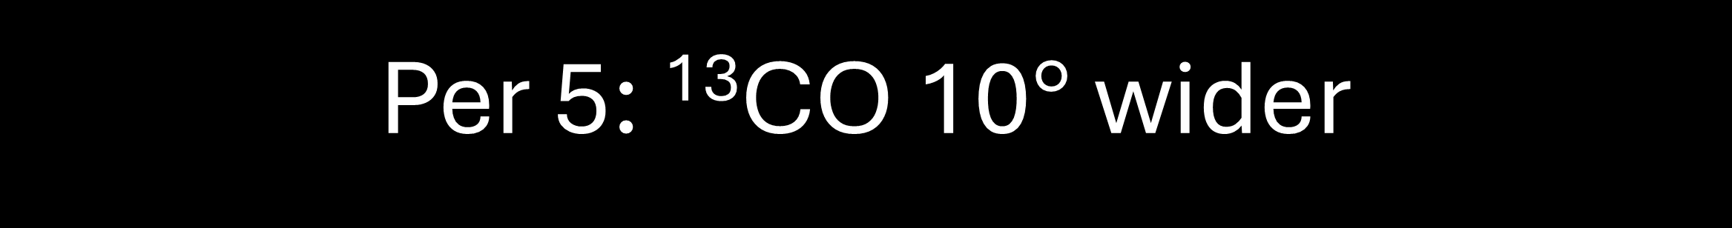
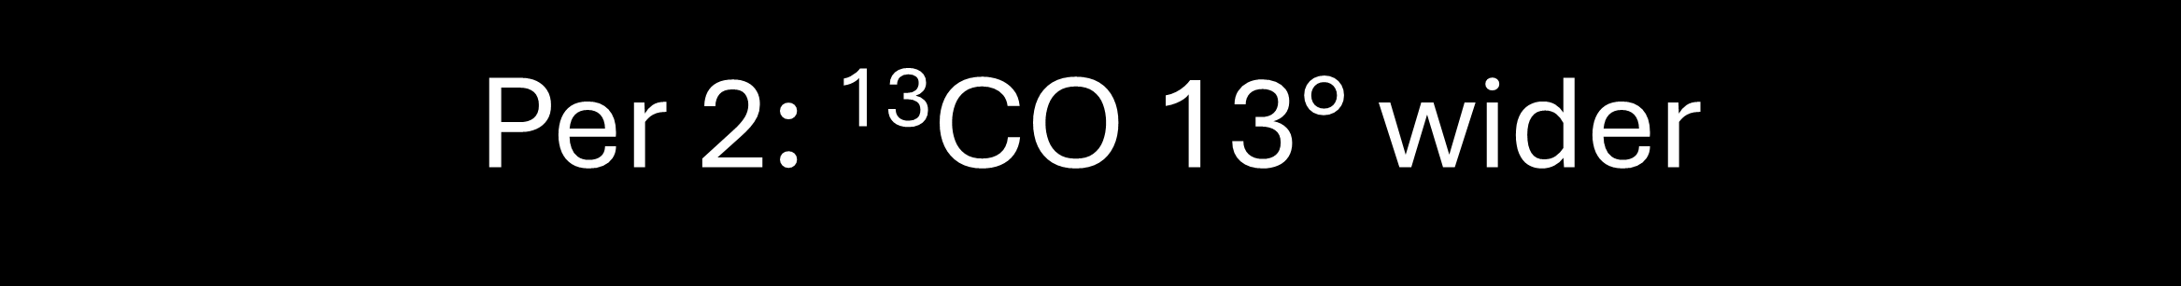
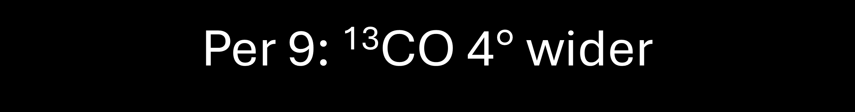
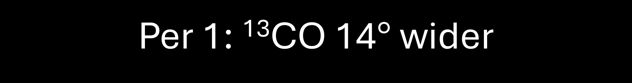
Using a Different Tracer to Measure Outflow Angles of Forming Stars
Wyatt Ulsh (Middlebury College), Michael Dunham (Advisor)
One major question that remains unanswered about stars is how exactly they gain their mass. If the stellar initial mass function (IMF) is inherited from the dense core mass function (CMF), as has been posited in the literature, around two thirds of the initial dense core mass must be ejected during the star formation process. Molecular outflows are suggested to be the agent that removes this mass, although it remains unclear if these bipolar outflows are capable of removing such a large fraction of the initial mass of the core. To investigate this, we look at the evolution of the opening angles outflows with time to see if the angles become wide enough to remove two thirds of the mass. While ¹²CO is typically used to image outflows since it is relatively abundant and as a result less challenging to observe, this research proposes that a different isotopologue of CO, ¹³CO, provides a more accurate measurement of the full widths of outflows. While ¹³CO is much harder to observe than the standard ¹²CO due to it being approximately two orders of magnitude less abundant, we show that it provides a more accurate result.
Per 1: ¹³CO 14$°$ wider
Per 9: ¹³CO 4$°$ wider
¹³CO
¹²CO
¹³CO
¹²CO
Per 2: ¹³CO 13$°$ wider
Per 26: ¹³CO 14$°$ wider
¹³CO
¹²CO
¹³CO
¹²CO
Per 5: ¹³CO 10$°$ wider
¹³CO
¹²CO
Questions about measurement method? Ask me!
13CO appears to give wider outflow angles; Additional measurements in progress

